Slide 1
Family Group in Cosmos.
Art & Technology
20201131
Hyunwoo Rhee
#09
Intro to Creative Computing

Slide 2
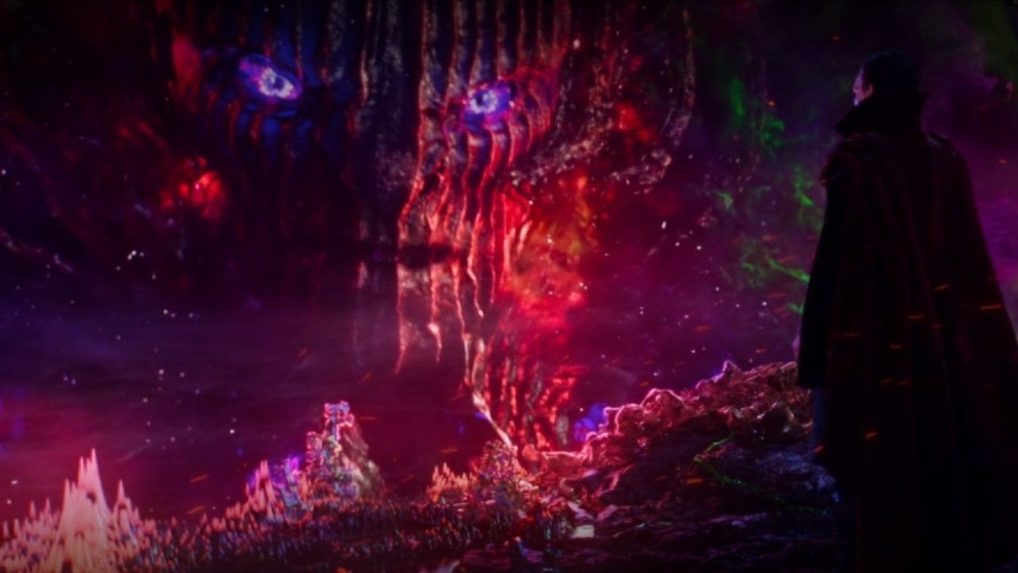
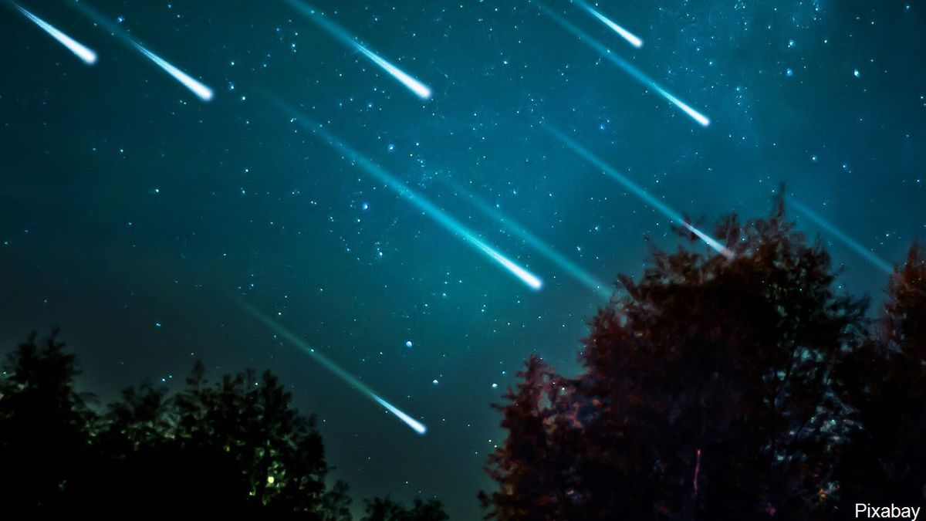
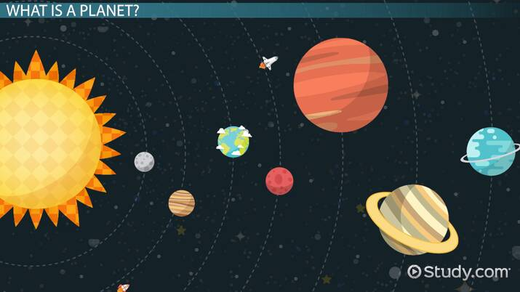
Visual Concept
Family.

Slide 3
Target Users.
Family.
Those who want to visualize the bonds of their families according to distance.
Those who want to see how we are protected within the framework of the family.

Slide 4
Features.
Family.
1
You can increase or decrease the distance between family members by scrolling the mouse.
2
You can pull one of your family members out of the shield.
3
You can set the cosmic background with your appearance.

Slide 5
Algorithm.
Family.
Cosmos Background
for every pixels
make new color from pixel, background color to dark color.
make circle r:30 at pixel position.

Slide 6
Algorithm.
Family.
Meteors crashed at Shield.
for every meteors
if meteor’s x, y ~ center distance <= barrierRadius and is not burn
N
explode meteor
Y
N
if meteor is not burn
if 400 – random(100, barrierRadius) >= 280
if meteor’s trace is end
Y
Y
move meteor
burn meteor
remove meteor from array
draw meteor
if meteor is burn but not explode
N
Y

Slide 7
Algorithm.
Family.
Meteors trace
for every traces
if trace length > 80 or out of screen, or is burn
N
Y
draw every traces
remove trace from array
if meteor is not exploded
N
if meteor is burn but not explode
Y
draw meteor and put new traces
set isTraceEnd true

Slide 8
Algorithm.
Family.
Meteor trace
set x, y to width / 2, height / 2 - 200
for frameCount – duration * 0.5 ~ 0
draw circle at 50 * cos(i), 50 * sin(i), i, step 5.

Slide 9

Screenshots.
Family.

Slide 10
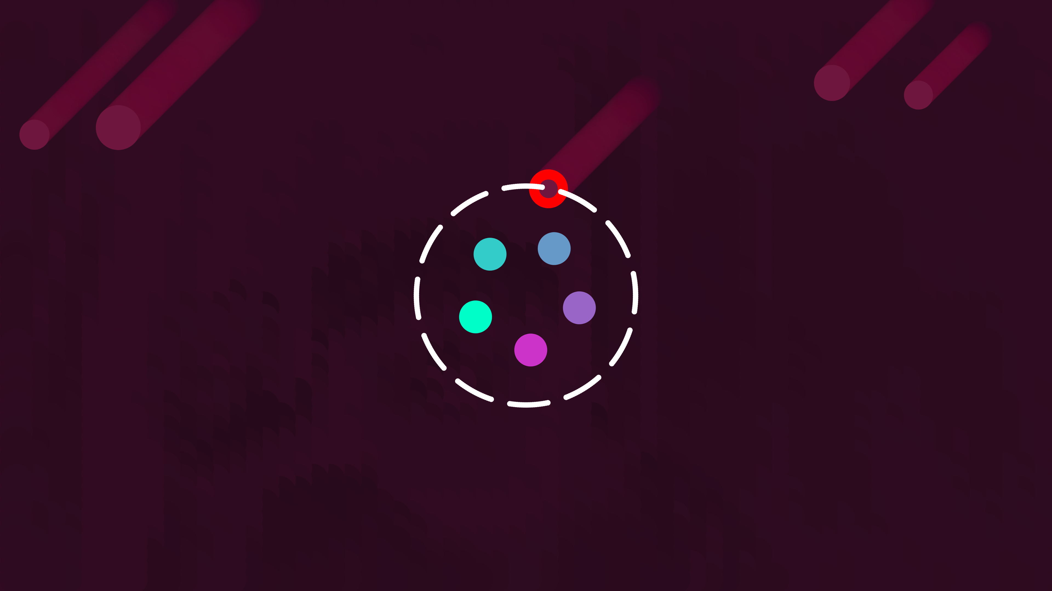
Screenshots.
Family.

Slide 11
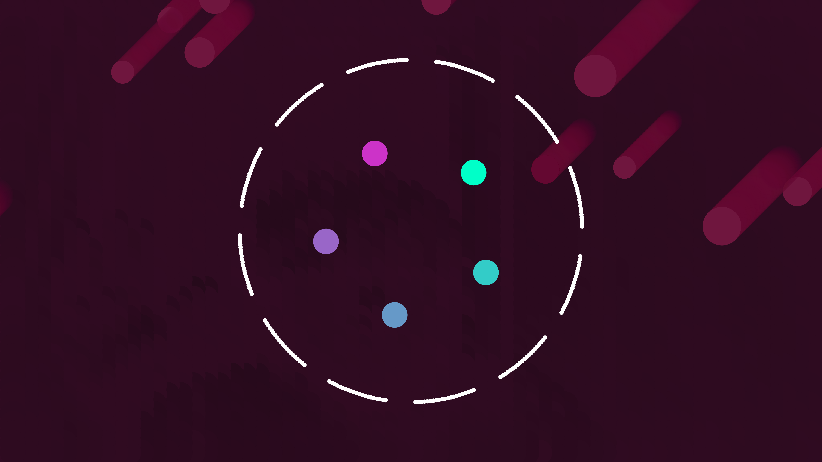
Screenshots.
Family.

Slide 12
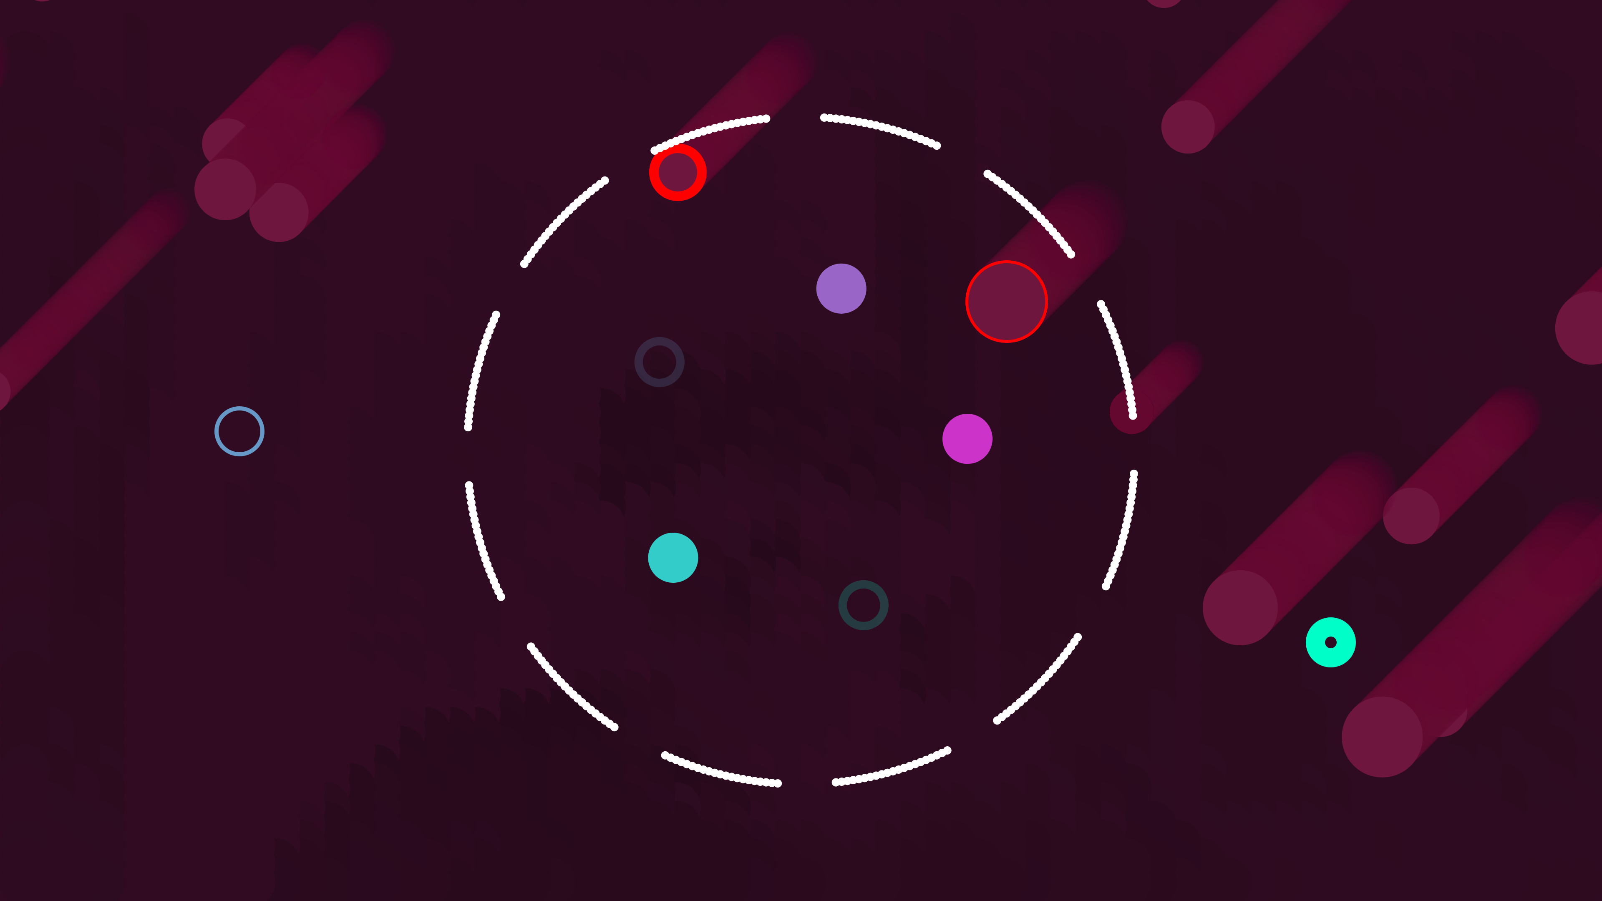
Screenshots.
Family.

Slide 13
Thank You.
#09
Find out my project :)
Background, but more delay
https://ienground.github.io/p9_CC/
No background, less delay
https://ienground.github.io/p9_CC/index2.html

